Slide 1
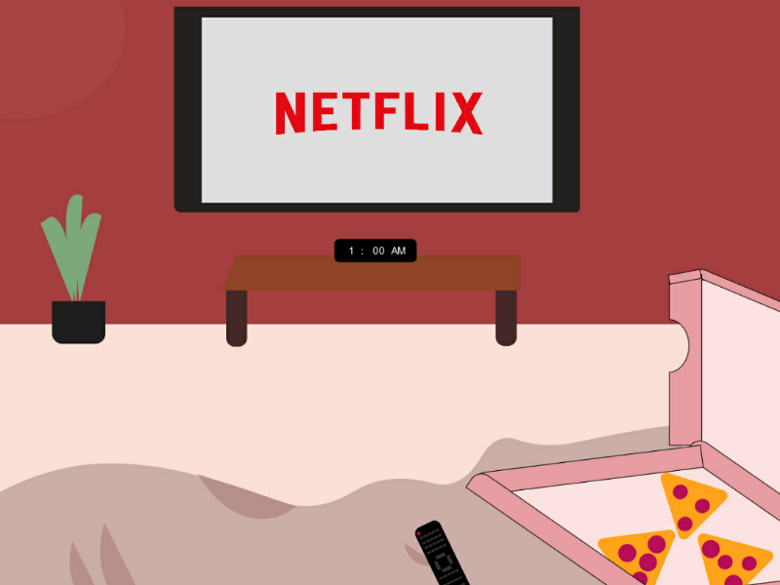


BIG DATA ANALYTICS ASSIGNMENT (CMS3504)
NETFLIX PRIZE DATA
DESCRIPTIVE AND PREDICTIVE ANALYSIS
U2058657(PRABANCHAN C V) U2077880(POORANI P)

Slide 2


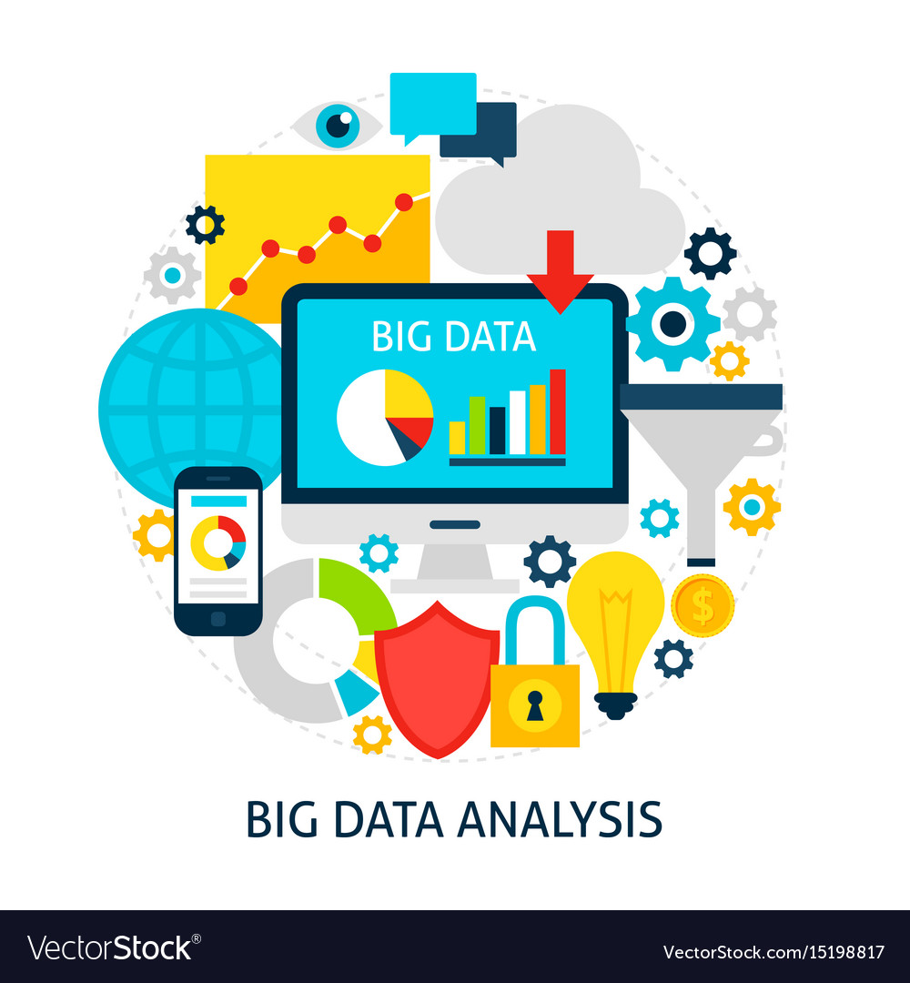
Introduction: Dimensions of datasets: Objective – Aim: Methods and Techniques: *Descriptive Analysis - EDA *Predictive Analysis - (Recommendation models) Conclusion:
Table of content

Slide 3



INTRODUCTION
According to Netflix, over 75% of viewer activity is based off personalised recommendations. Netflix collects several data points to create a detailed profile on its subscribers. Most significantly, Netflix collects customer interaction and response data to a TV show.
……………………………………………………………………………………………………………………………
Netflix knows the time and date a user watched a show, the device used, if the show was paused, does the viewer resume watching after pausing? Do people finish an entire TV show or not, how long does it take for a user to finish a show and so on.
……………………………………………………………………………………………………………………………
In this project, we aim to build a movie recommendation mechanism within Netflix. This will support people best possible on their way through life, it is necessary to have an optimal recommendation on hand.

Slide 4


Dimensions of data
The dataset we used has been taken from Netflix.
It consists of 4 text data files,
Each file contains over 20M rows, i.e. over 4K movies and 400K customers.
All together over 17K movies and 500K+ customers!
The data were collected between October, 1998 and December, 2005 and reflect the distribution of all ratings received during this period. The ratings are on a scale from 1 to 5 (integral) stars. To protect customer privacy, each customer id has been replaced with a randomly-assigned id. The date of each rating and the title and year of release for each movie id are also provided.
The dataset has information like User details, Rating, Date, Movie year, Movie name, Customer ID, and Movie Ratings.
Challenges:
To get all these data loaded into the Kernel for analysis, We have encountered Memory error while working with this dataset.

Slide 5

Objective - Aim
To find the hidden pattern of the data – Exploration of data (Data Visualization of Data)
To predict movies list by using Collaborative Filtering on what user liked in the past.
To predict movies that are highly Correlated to one another by using Pearson correlation.

Slide 6

Techniques and Methods
Data Manipulation
Cleaning & Slicing the data:
The data volume has been reduced to improve the data quality:
Removed movie with too less reviews (they are relatively not popular)
Removed customer who gave too less reviews (they are relatively less active)
Data Mapping:
Performed data mapping to allow the movie file to be used and recorded for our purpose and to facilitate interoperation between data sets and software that are similar but not exactly the same.

Slide 7
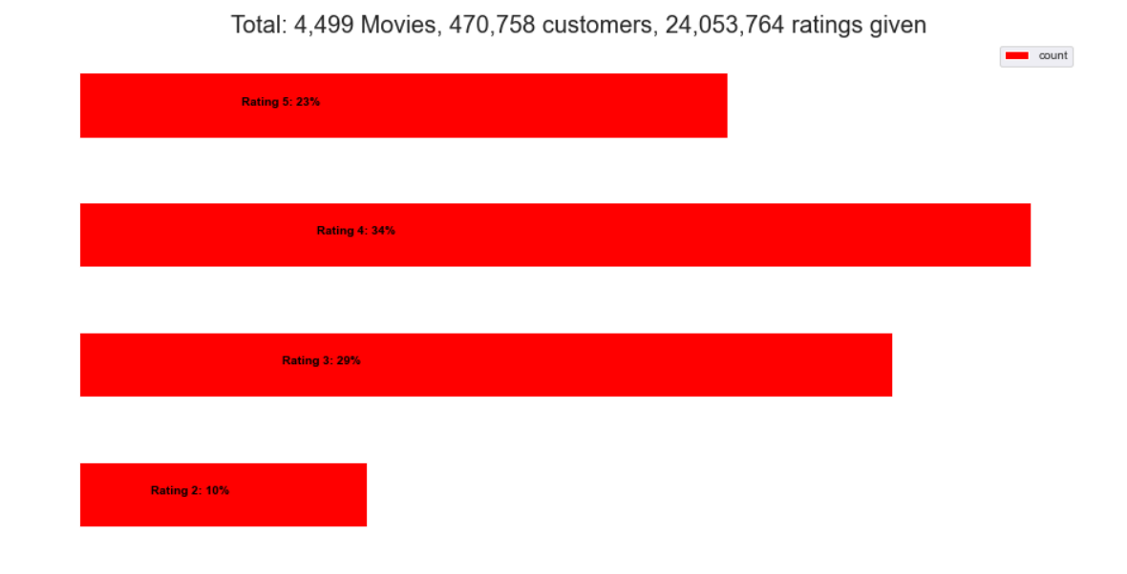
Techniques and Methods
Descriptive analysis - EDA
Netflix Rating Distribution:

Slide 8
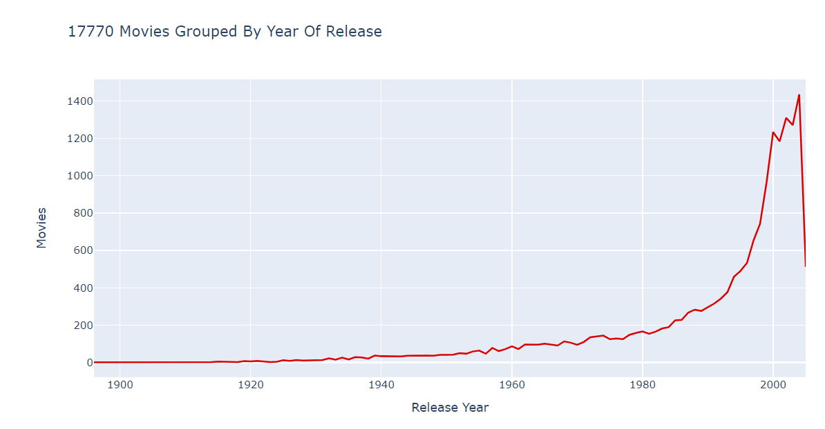
Techniques and Methods
Descriptive analysis - EDA
Movies Grouped by year of Release:

Slide 9
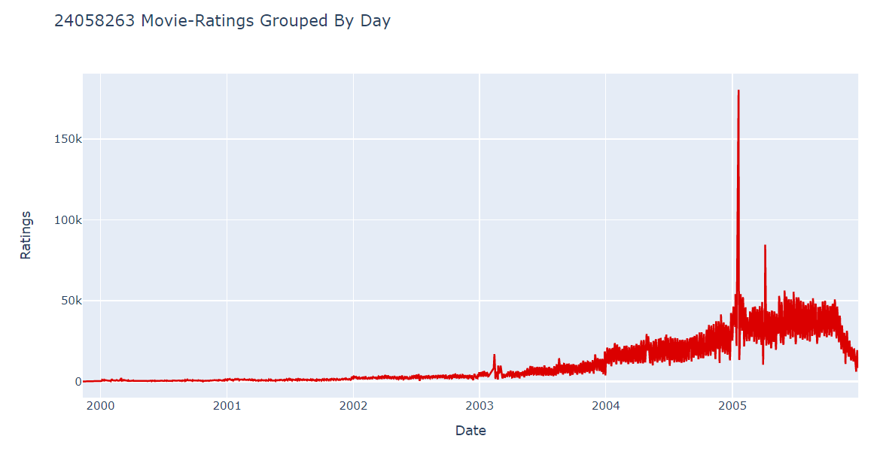
Techniques and Methods
Descriptive analysis - EDA
Movie rating grouped by day:

Slide 10
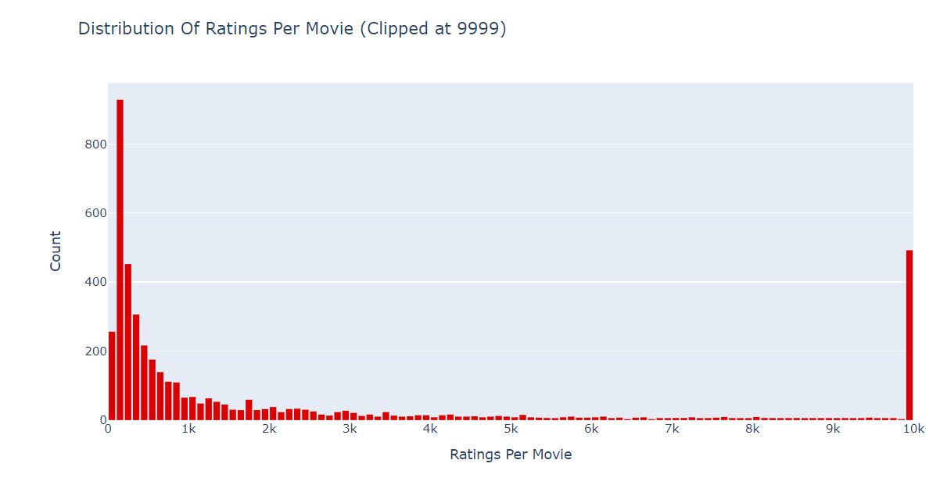
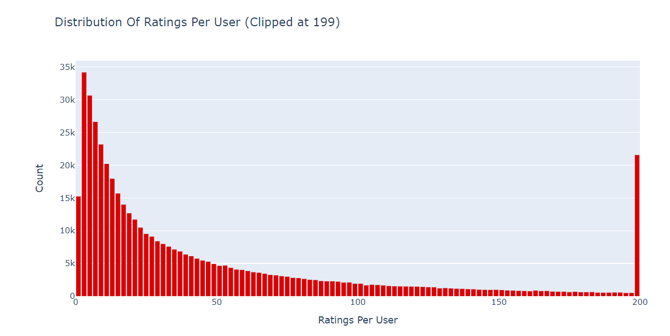
Techniques and Methods
Descriptive analysis - EDA
Distribution Of Ratings Per Movie:
Distribution Of Ratings Per user:

Slide 11
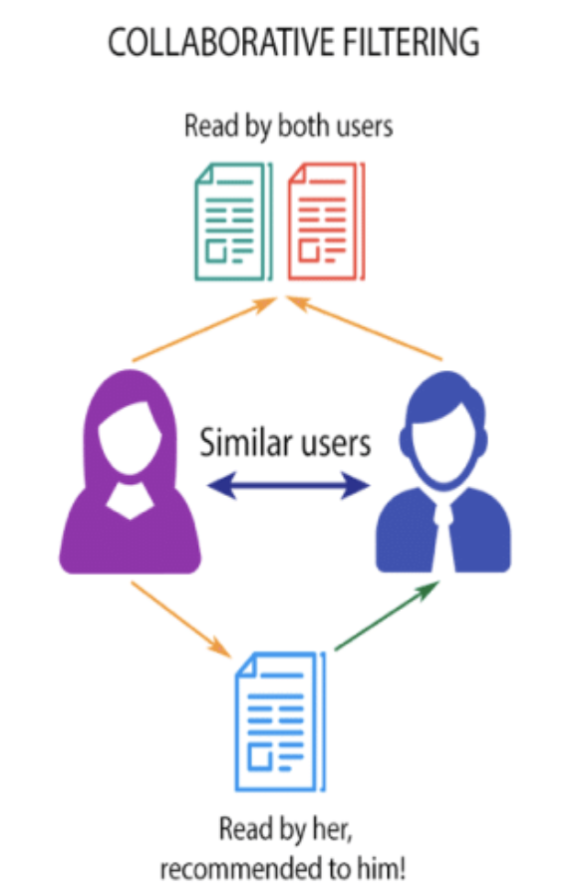

Techniques and Methods
Predictive analysis
Collaborative Filtering
Collaborative Filtering provides recommendations based on the similar profiles of its users. One key advantage of collaborative filtering is that it is independent of the product knowledge. Rather, it relies on the users with a basic assumption that what the users liked in the past will also like in the future. For example, if a person A watches crime, sci-fi and thriller genres and B watches sci-fi, thriller and action genres then A will also like action and B will like crime genre.
Pearsons' R correlations
Pearson's correlation coefficient is the test statistics that measures the statistical relationship, or association, between two continuous variables. It gives information about the magnitude of the association, or correlation, as well as the direction of the relationship.

Slide 12
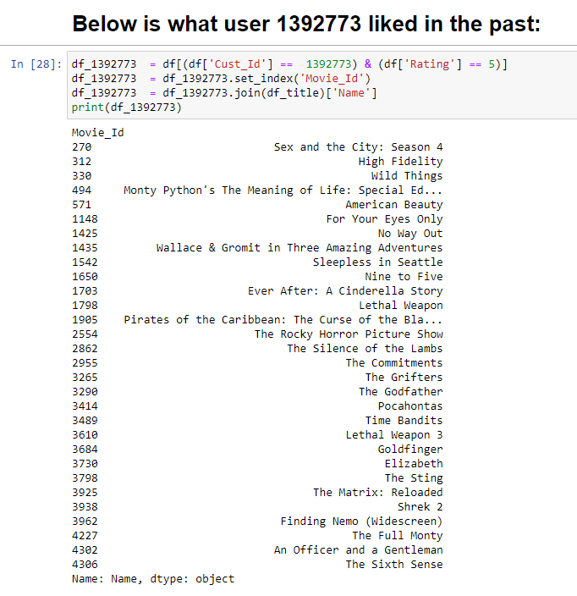
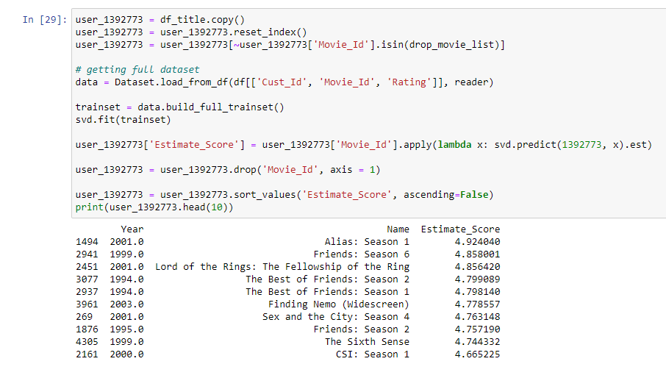
Techniques and Methods
Predictive Analysis –Recommendation Models
Recommendation with Collaborative Filtering:

Slide 13
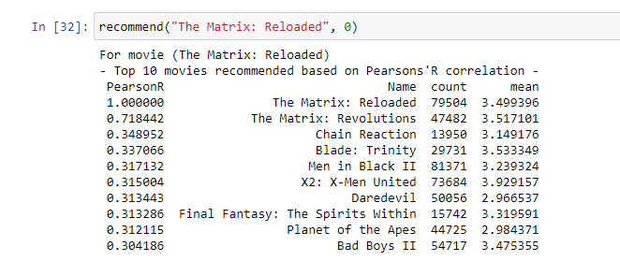
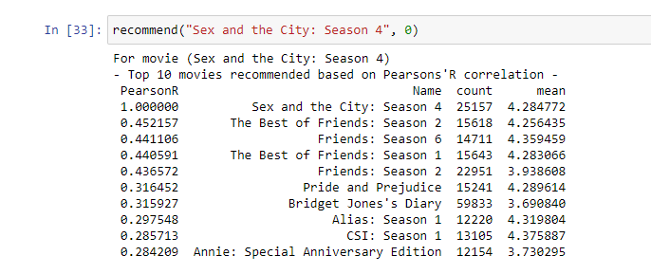
Techniques and Methods
Predictive Analysis –Recommendation Models
Recommendation with Pearsons' R correlations:
For movie “Matrix Reloaded”: Top 10 recommended movies
based on Pearson Correlation
For movie “Sex and the city –season 4” : Top 10 recommended movies
based on Pearson Correlation

Slide 14
Conclusion
Critical Evaluation:
The recommendation system we used is well established and has been widely used by many already. We were not able to provide much novelty with the given dataset.
Scope for future work:
* More additional data could be added to the dataset, which allows more combinations of the hybrid model that could lead to a more accurate recommender system.
* The model could be programmed better, which will speed up the run time dramatically. If one improves this script in such way the runtime decreases, one might achieve better results in the end because tweaking the model will become easier.
Conclusion:
There are many different ways to set up a recommender system. Based on the objectives we have framed, we used appropriate descriptive and predictive analysis to derive the outcome from the given dataset.

